Slide 1

MODULE 2
Master of Computer Applications /
Master of Science in Information Technology
Subject code – Fundamentals of Big Data
INTRODUCTION TO APACHE HADOOP

Slide 2

MODULE NO.2
Exploring the World of Hadoop
SEARCH ENGINE INNOVATORS LIKE YAHOO! AND GOOGLE NEEDED TO FIND A WAY TO MAKE SENSE OF THE MASSIVE AMOUNTS OF DATA THAT THEIR ENGINES WERE COLLECTING. THESE COMPANIES NEEDED TO BOTH UNDERSTAND WHAT INFORMATION THEY WERE GATHERING AND HOW THEY COULD MONETIZE THAT DATA TO SUPPORT THEIR BUSINESS MODEL. HADOOP WAS DEVELOPED BECAUSE IT REPRESENTED THE MOST PRAGMATIC WAY TO ALLOW COMPANIES TO MANAGE HUGE VOLUMES OF DATA EASILY. HADOOP ALLOWED BIG PROBLEMS TO BE BROKEN DOWN INTO SMALLER ELEMENTS SO THAT ANALYSIS COULD BE DONE QUICKLY AND COST-EFFECTIVELY.
DR, LAKSHMI J V N ASSOCIATE PROFESSOR SCHOOL OF CS & IT

Slide 3
Hadoop Distributed File System: A reliable, high-bandwidth, low-cost, data storage cluster that facilitates the management of related files across machines.
✓ MapReduce engine: A high-performance parallel/distributed data processing implementation of the MapReduce algorithm.
DR, LAKSHMI J V N ASSOCIATE PROFESSOR SCHOOL OF CS & IT

Slide 4
The Design of HDFS
Very large files
Streaming data access
Commodity hardware
Low-latency data access
Lots of small files
Multiple writers, arbitrary file modifications
DR, LAKSHMI J V N ASSOCIATE PROFESSOR SCHOOL OF CS & IT

Slide 5
HDFS Concepts
Blocks
A disk has a block size, which is the minimum amount of data that it can read or write. Filesystems for a single disk build on this by dealing with data in blocks, which are an integral multiple of the disk block size. Filesystem blocks are typically a few kilobytes in size, while disk blocks are normally 512 bytes. This is generally transparent to the filesystem user who is simply reading or writing a file—of whatever length. However, there are tools to perform filesystem maintenance, such as df and fsck, that operate on the filesystem block level.
DR, LAKSHMI J V N ASSOCIATE PROFESSOR SCHOOL OF CS & IT

Slide 6
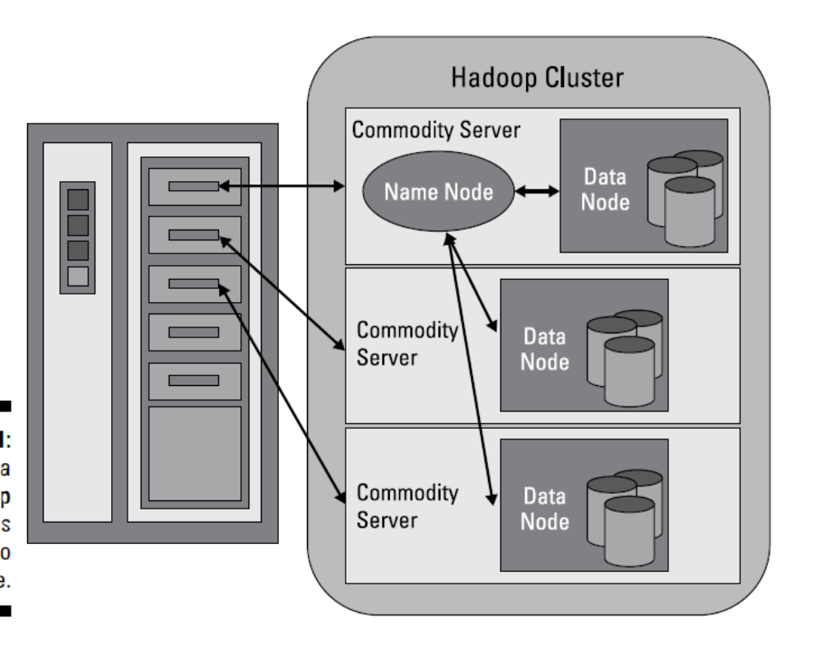
Understanding the Hadoop Distributed File System (HDFS)
DR, LAKSHMI J V N ASSOCIATE PROFESSOR SCHOOL OF CS & IT

Slide 7
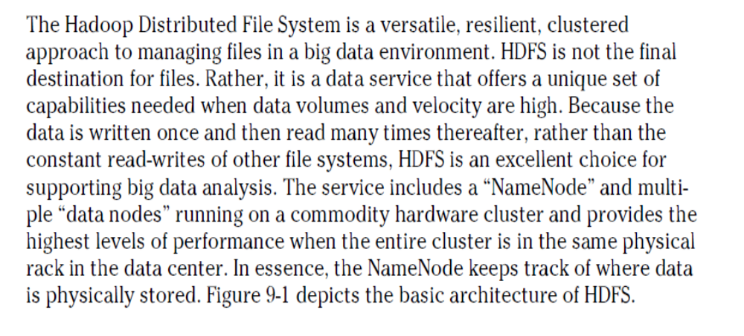
DR, LAKSHMI J V N ASSOCIATE PROFESSOR SCHOOL OF CS & IT

Slide 8
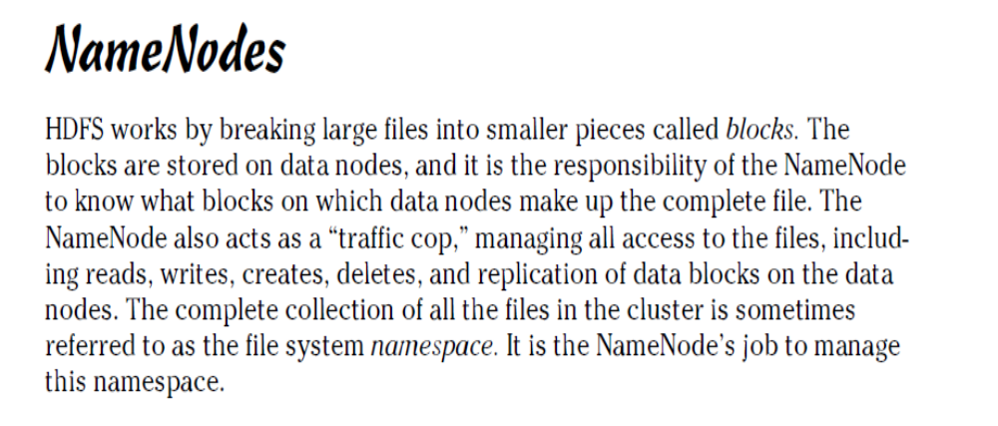
DR, LAKSHMI J V N ASSOCIATE PROFESSOR SCHOOL OF CS & IT

Slide 9
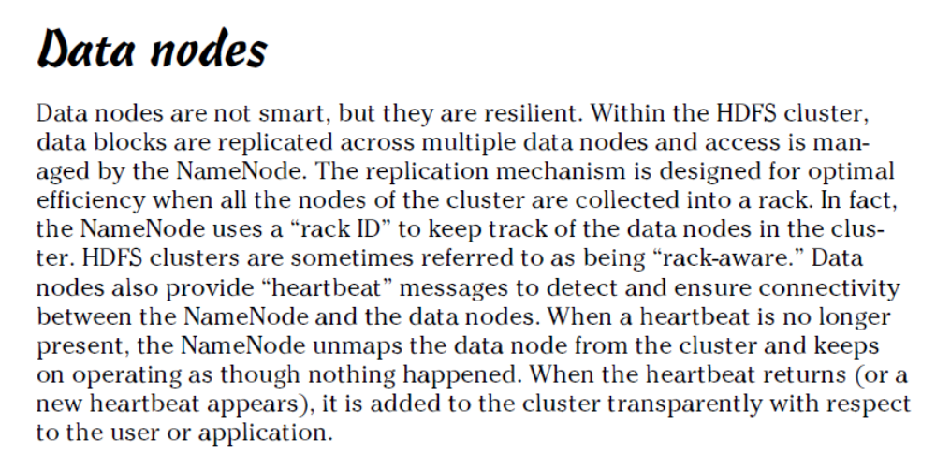
DR, LAKSHMI J V N ASSOCIATE PROFESSOR SCHOOL OF CS & IT

Slide 10
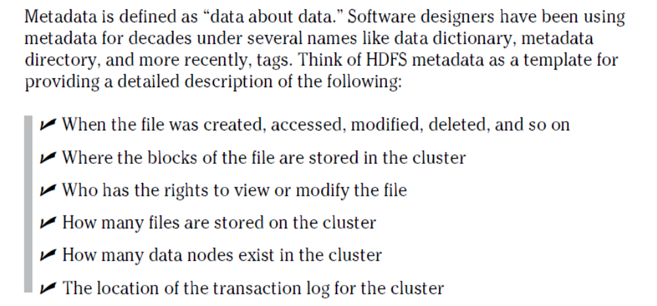
DR, LAKSHMI J V N ASSOCIATE PROFESSOR SCHOOL OF CS & IT

Slide 11
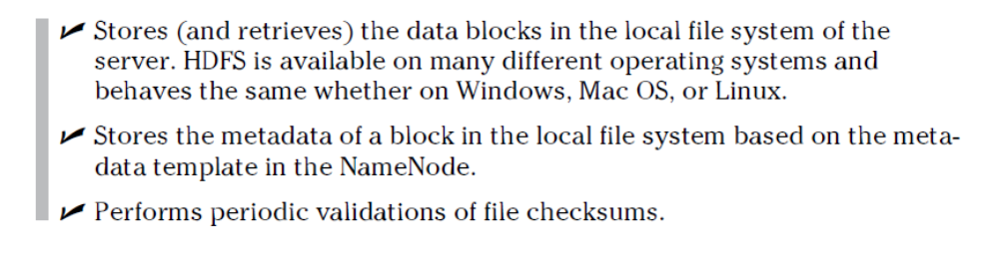
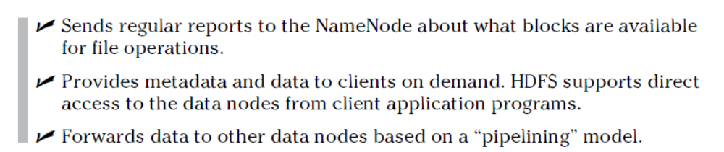
DR, LAKSHMI J V N ASSOCIATE PROFESSOR SCHOOL OF CS & IT

Slide 12

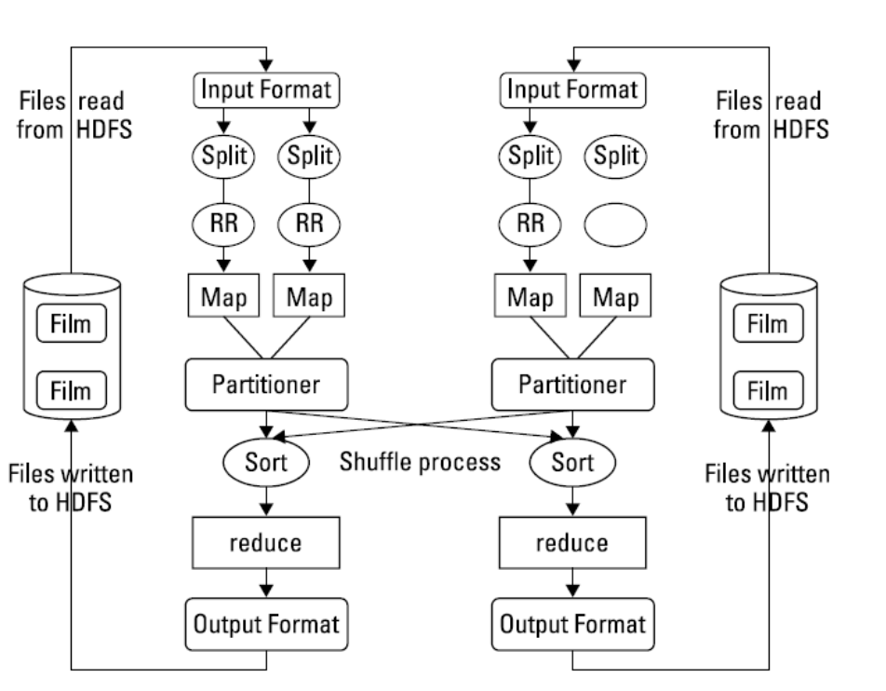
DR, LAKSHMI J V N ASSOCIATE PROFESSOR SCHOOL OF CS & IT

Slide 13
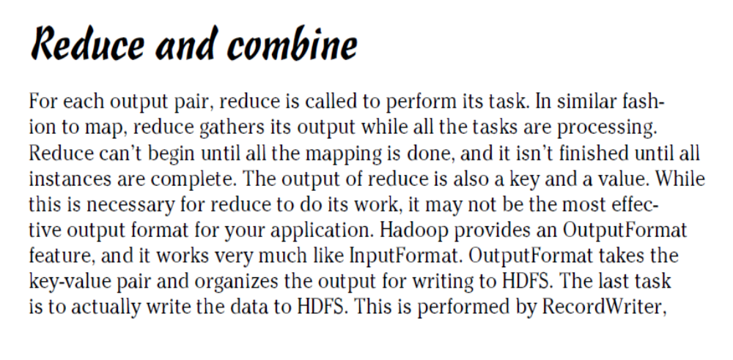
DR, LAKSHMI J V N ASSOCIATE PROFESSOR SCHOOL OF CS & IT

